Slide 1
Integration with JobSense :Design Conceptualization
Content:
JobVerse

Slide 2
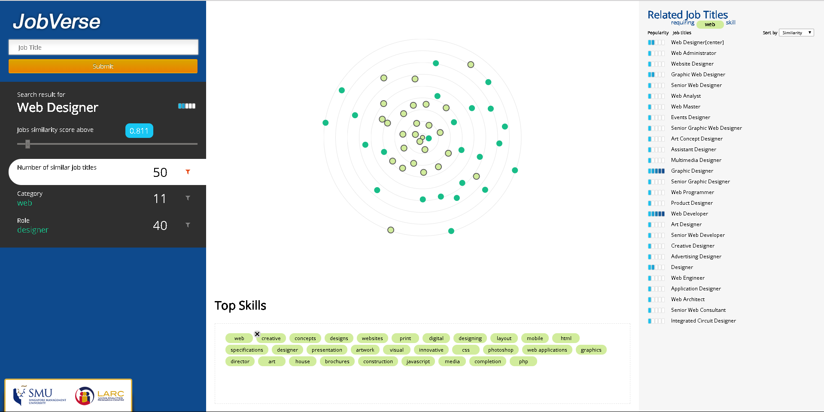
Category
Jobs
Role
Related Skills

Slide 3
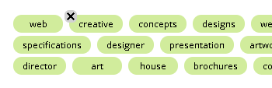
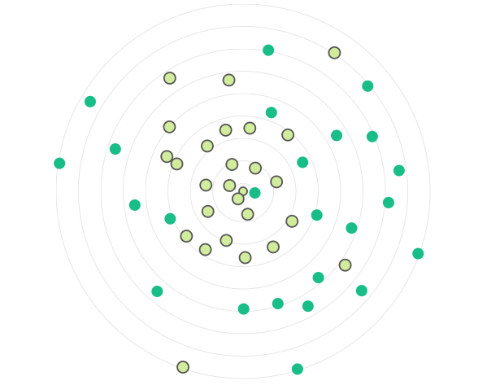
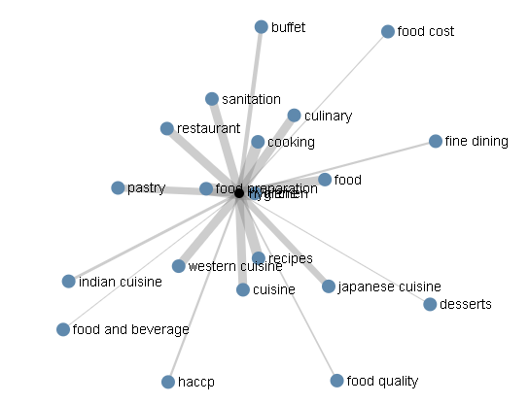
Skills
DESIGN CONCEPTUALIZATION
Category Network
Skills :Correlation network
Web
Web
Web
Creative
Art
Graphic Web
Website
Web
Application
integrated circuit

Slide 4
Skills
DESIGN CONCEPTUALIZATION
Role Network
Skills :Correlation network
Consultant
Architect
Engineer
Designer
Designer
Designer
Designer
Administrator
Designer
Designer

Slide 5
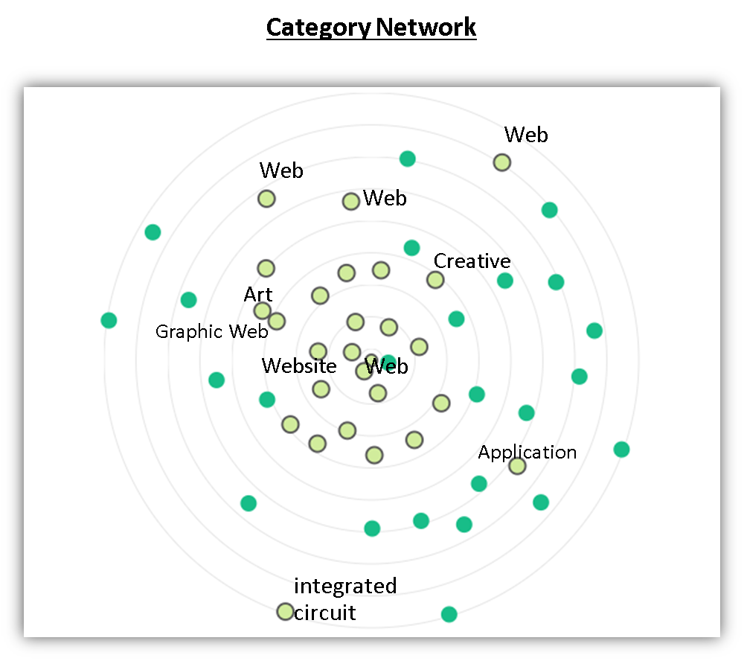
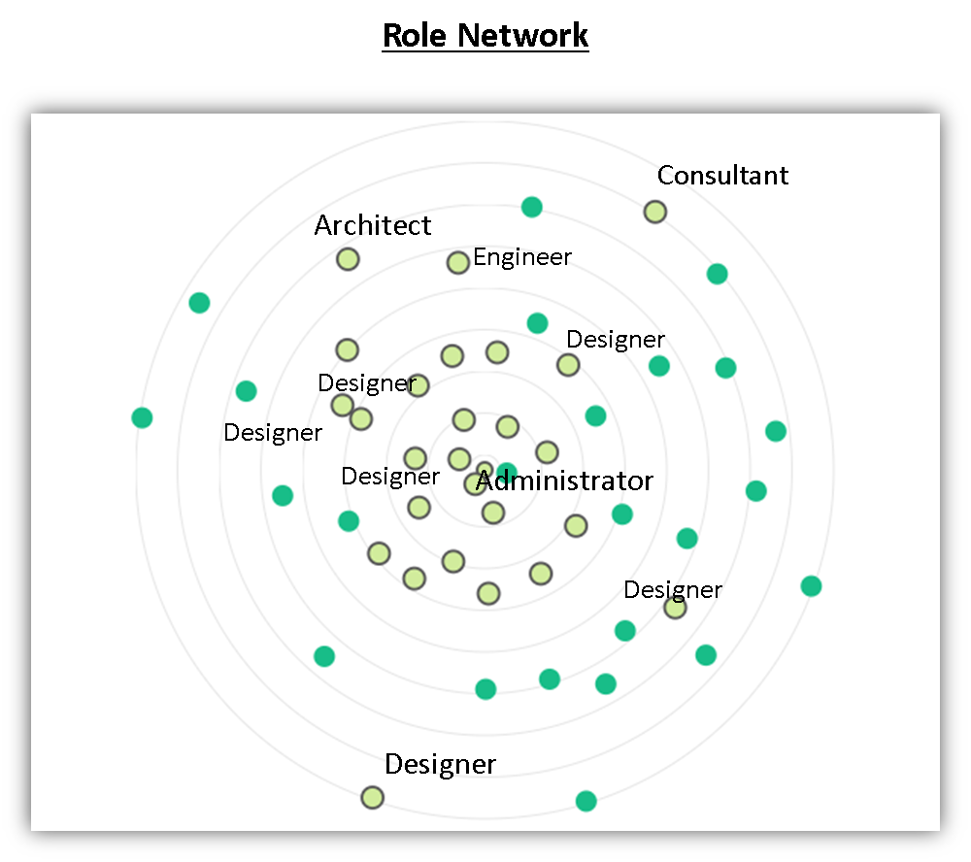
Skills
Skills
DESIGN CONCEPTUALIZATION
Enable:
-Job Category Distance Visualization
-Job Role Distance Visualization

